Slide 1
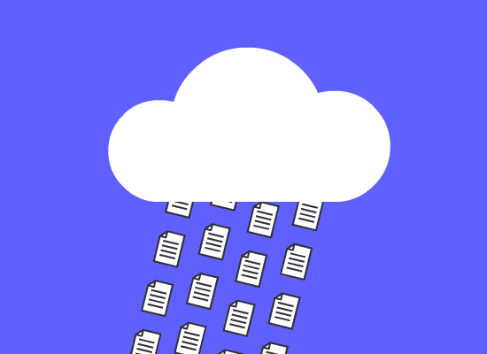
Basics of
Cloud Computing

Slide 2
About Myself
Ayan Banerjee
Software Engineer @Lexmark - RnD department
Contact Details - (+91)9088246290
Mail - ayanbanerjee.jobs@gmail.com
GitHub Url - https://github.com/ayanNullPointerEx

Slide 3
Request everyone to keep their microphones silent
In case U have any question pls write the questions in the chat box. We will discuss it at theend of presentation.

Slide 4
Feel Free to ask Questions

Slide 5
Prerequisites -
Html page - static / dynamic
Server - Web / Application server
Outcome of this session -
Basic understanding about what cloud is.

Slide 6
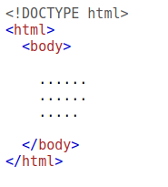
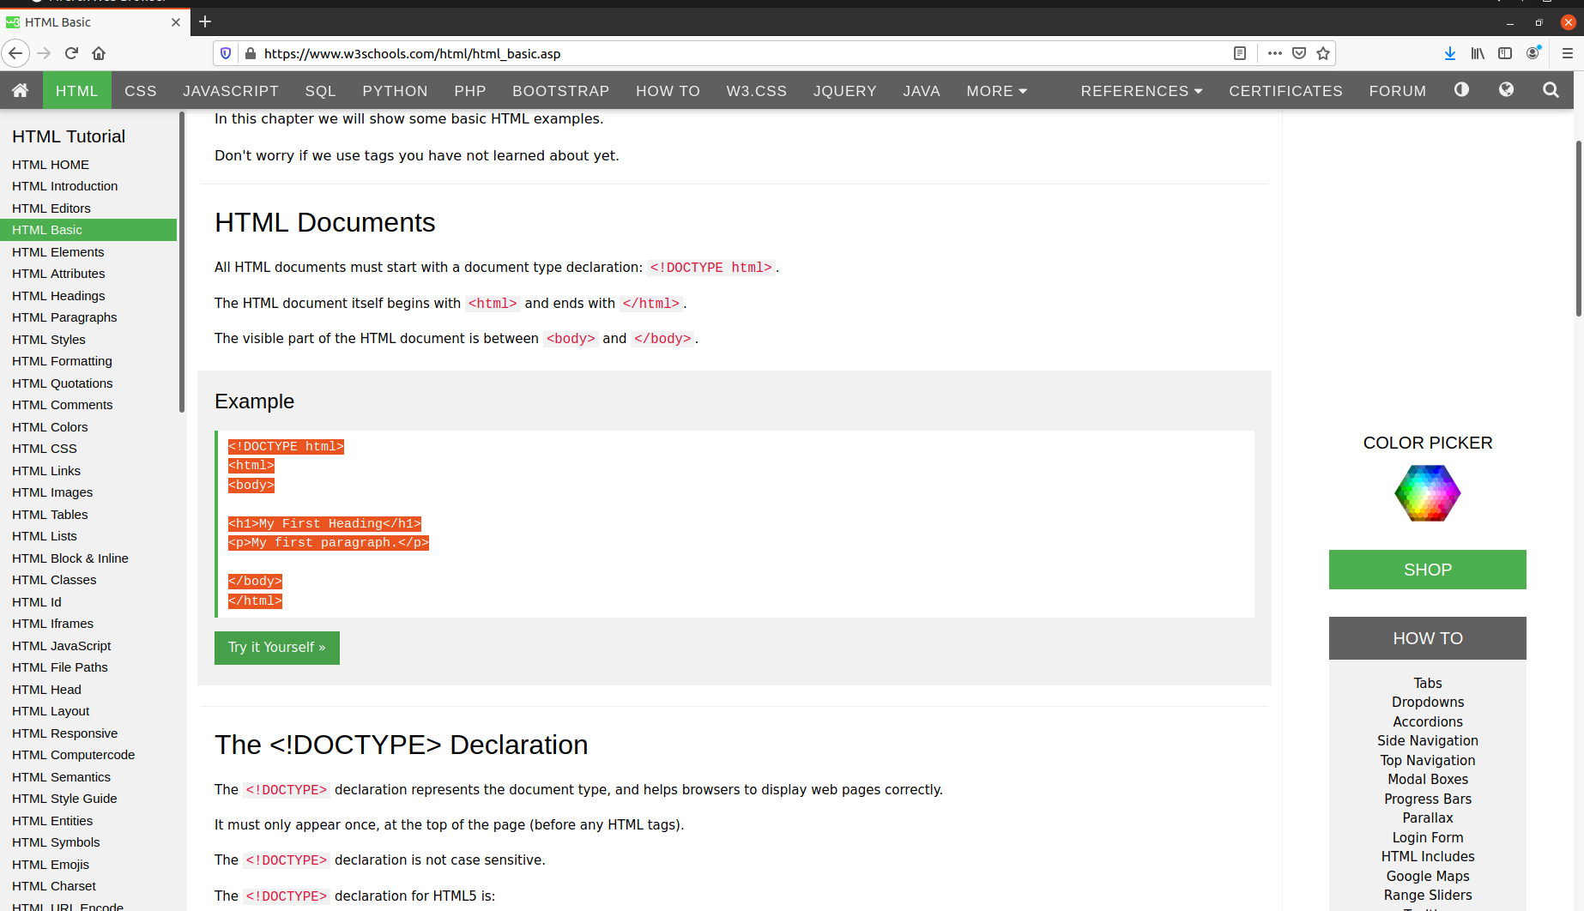
What is a HTML Page ?
<=>

Slide 7
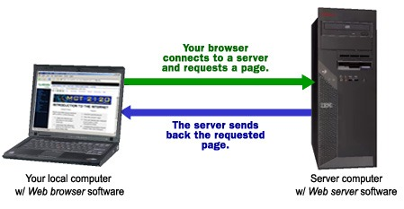
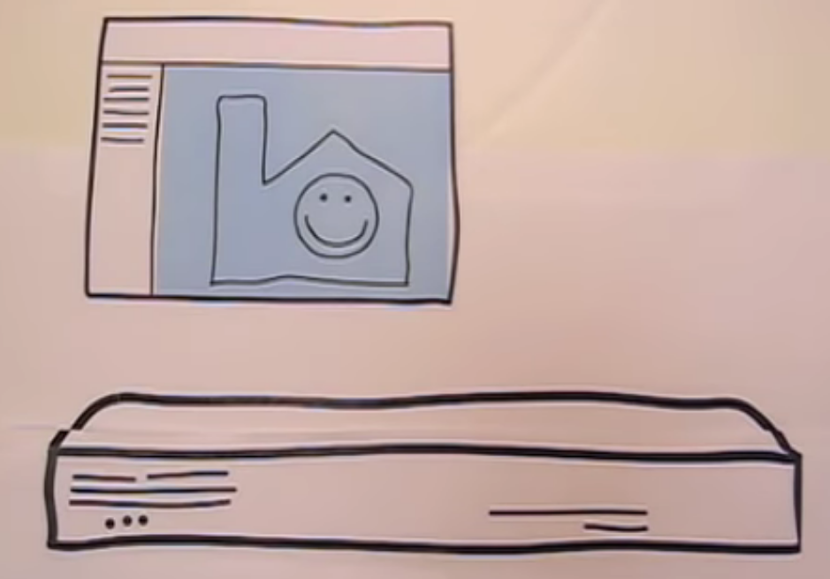
What is Server ?
A Computer - Desktop, Laptop, etc.
Install a Server application (e.x - Apache,Tomcat,IIS,etc)
Deploy the application code

Slide 8
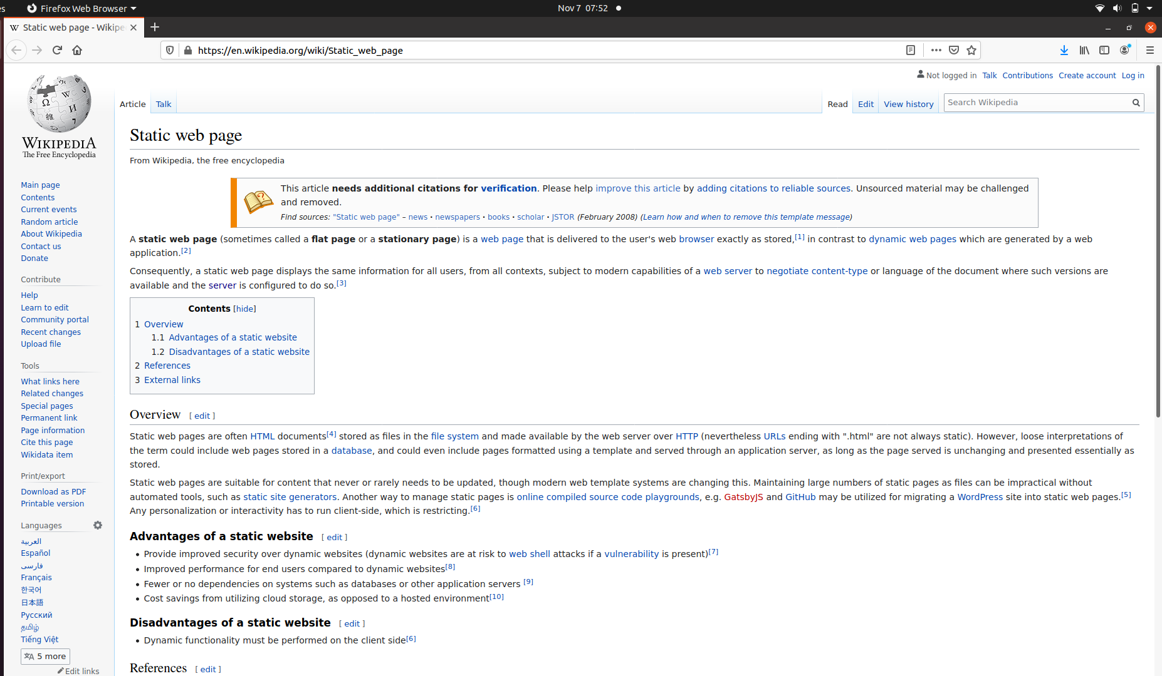
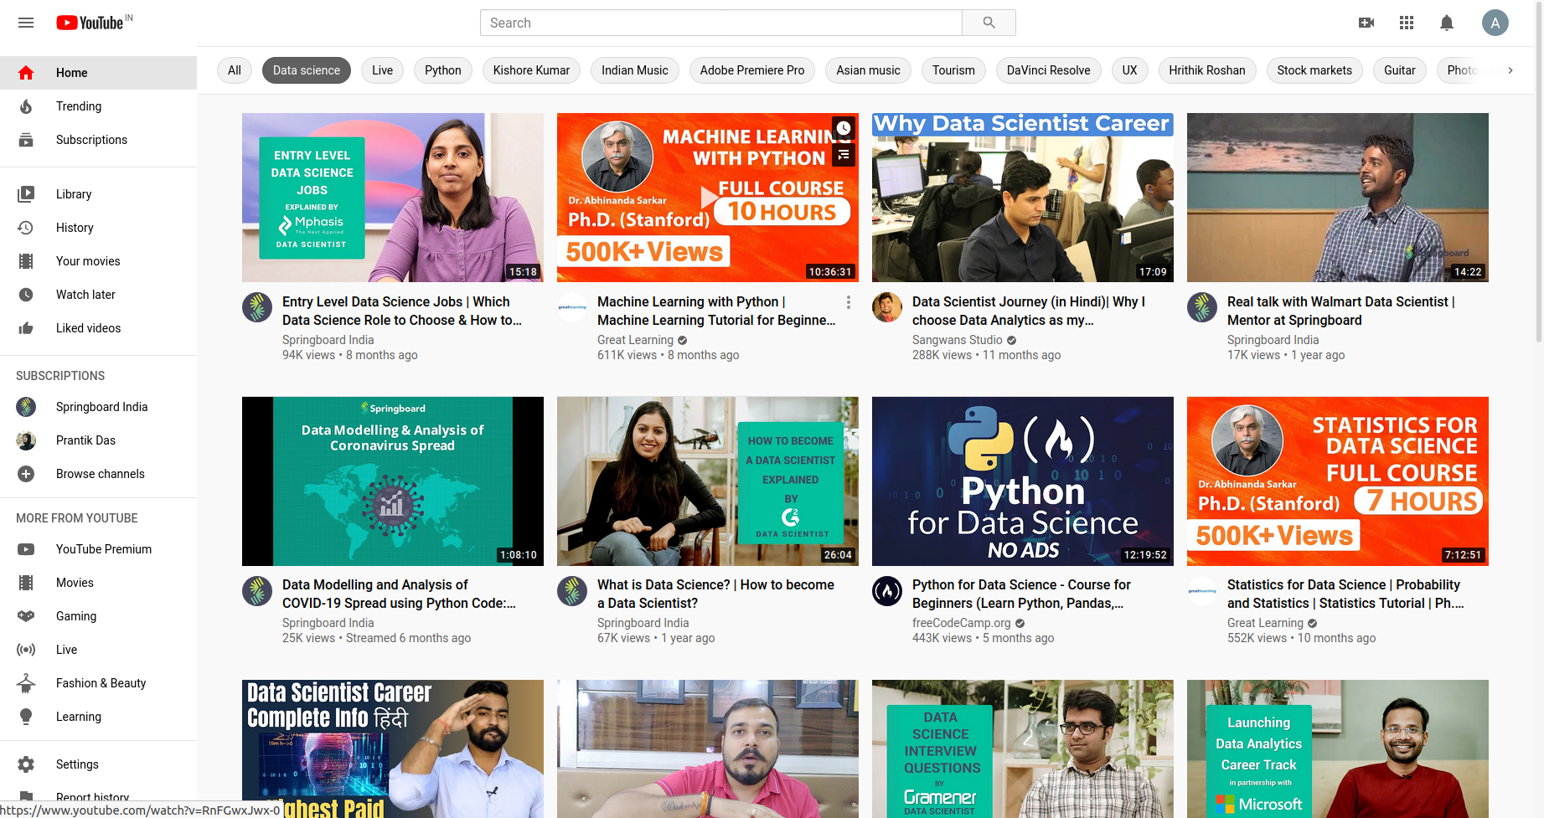
Types of Servers -
Web Server - for static resources
Application Server - dynamic websites , more interactive

Slide 9
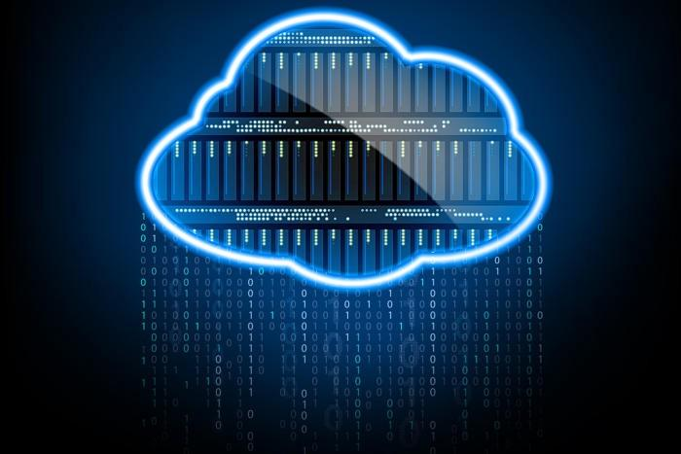
Cloud Computing

Slide 10

Online Shopping portal Example -
Imagine 2 friends, Ayan n Sayan wants to create a online shopping portal for their business.
So where to start ??

Slide 11

I wanna host a website .. How to do ?? 🤔
Build the website, write lines of html (UI) code, application server code
Buy a computer & install server in it.
Buy a leased line (Internet) n domain.
Maintenance & troubleshooting

Slide 12

U think thats all ?
Oh Noo!! Wait..

Slide 13
Online Shopping portal Example contd. -
Ayan: A server can handle a finite amount of traffic - say 1000 requests/second.
What if we get 1500 requests ???
Sayan: Simple, we buy another computer and a router to distribute traffic.

Slide 14
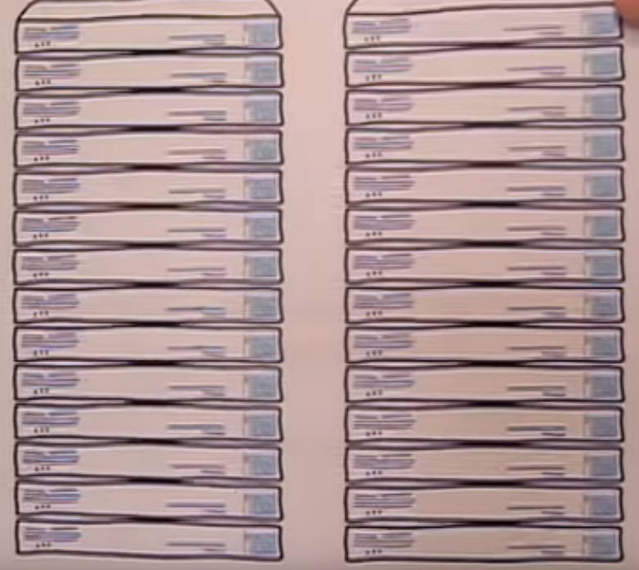
Ayan: What if we get 10 times more traffic ??
Sayan: Why buy more servers.
Ayan: Okayyy but it may cost U more than 10 Lakhs, are U sure U gonna spend that much for a small business ??
Sayan: Well I didn’t think abt that
Ayan: What if U get this load only once a year rest of the time U can manage with a single server.
Sayan: 🤔 Well I don’t know …

Slide 15
Continue ...
Ayan: Let’s assume me manage 50 new server machines. But who is gonna install all softwares / deploy the application ?
Sayan: mmm ….. 🤔
Ayan: How much time is required to host the software in all the machines and do the required networking ?
Ayan: Will the leased line broadband allow such huge amount of traffic ?
Ayan: What if the network breaks ??
Ayan: In case of any issue how am I alone gonna manage the entire architecture ?

Slide 16

Sayan: Hmmm ……… really too much

Slide 17

Well, what if I say Cloud has solution to all the problems !!

Slide 18
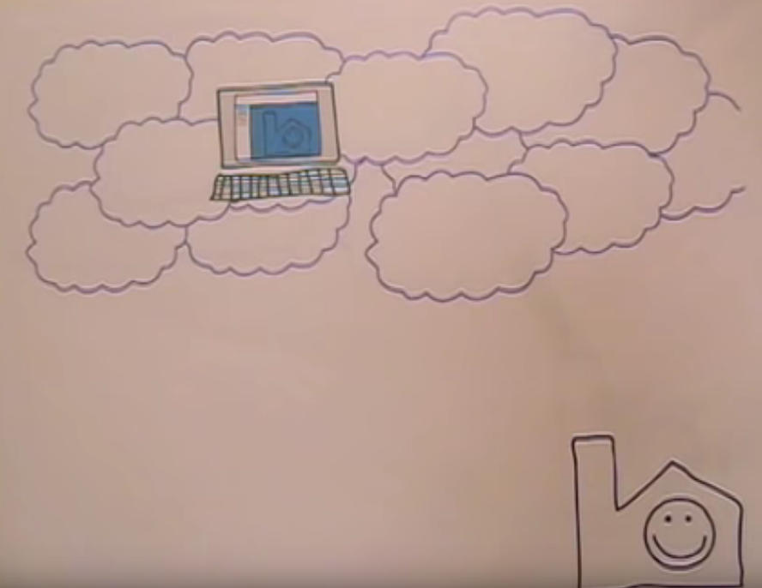
So what is CLOUD ?? “Cloud is about how you do computing, not where you do computing," goes a popular refrain in the domain of modern computing.
Imagine they have another friend named - Cloud. They give their code to him, n he takes care of everything else.
He creates a server installs all required softwares for them and deploys the code in server.
Oh I forget to tell, Mr. Cloud has supernatural abilities. He can create servers real quick like he can spin up 100 servers in 1 min n deploy code. N he uses a network line that never goes down.
He is also too kind, he don’t take the cost of all the machines. They have to pay him on on rent basis.

Slide 19
Move the app from local system to machines stored in cloud provider data centre.

Slide 20
Salient Features of Coud -
Autoscaling
Automatic setup
Automatic load balancing
Distributed globally

Slide 21
Autoscaling

Slide 22
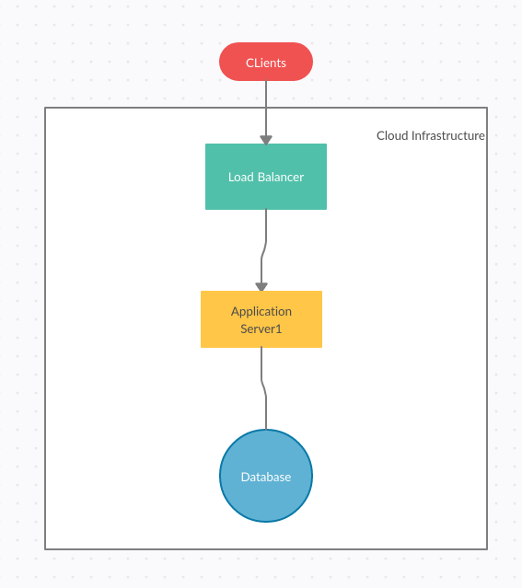
Load = (Expected CPU Load) / (Max CPU Load) * 100
Load > 80%,span a new server

Slide 23
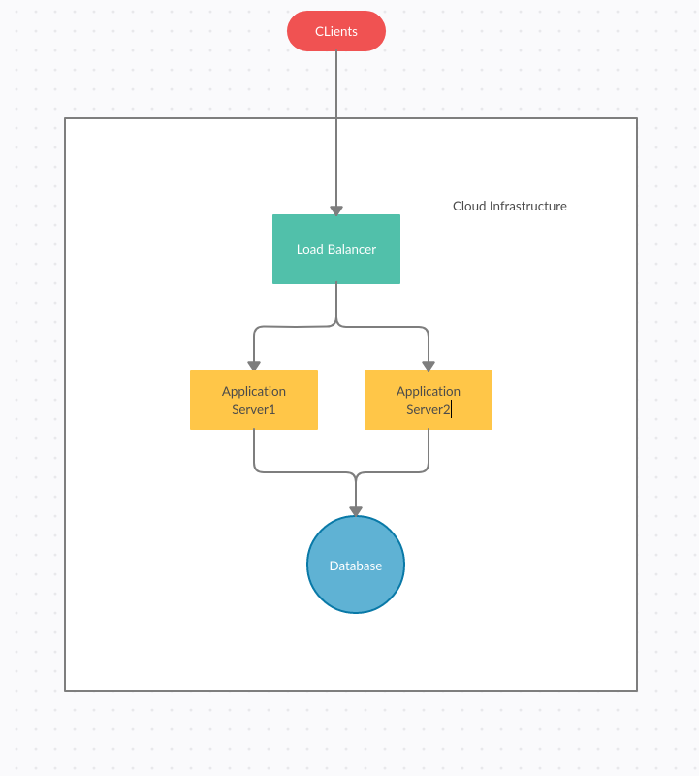

Slide 24
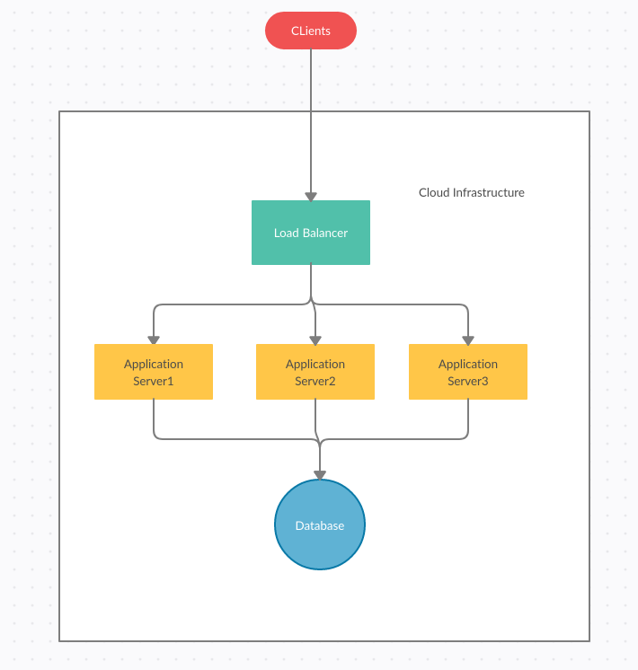

Slide 25
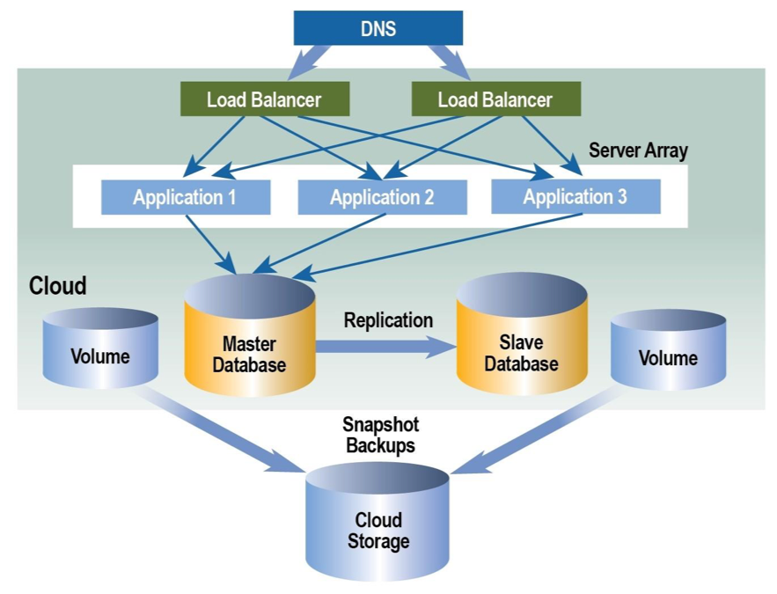
Automatic Load balancing -

Slide 26
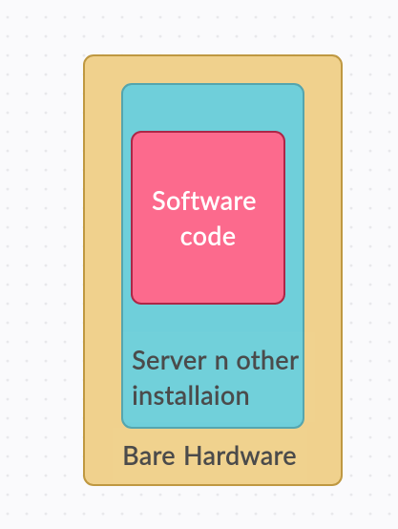
Automatic Setup
Devops engineers provides a script.
This script lists down softwares to be installed n other setup activity.
The cloud management tool executes the statements.
This script is executed automatically when a new server is instantiated.

Slide 27
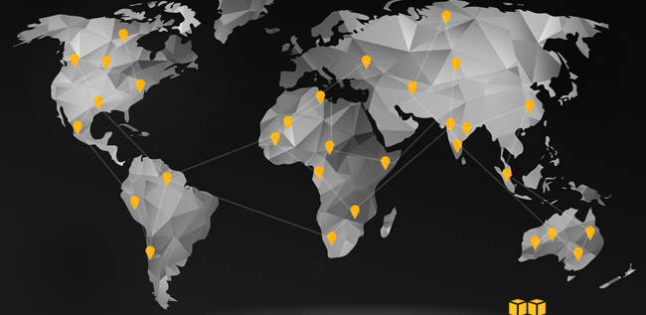
Distributed worldwide

Slide 28


Slide 29
Cloud Example -
Pokemon GO -
Developed in cloud
There was a enormous surge of traffic.
It had 50 times more traffic than it was planned for.
It was able to handle the entire load.
That’s the MAGIC of Cloud

Slide 30
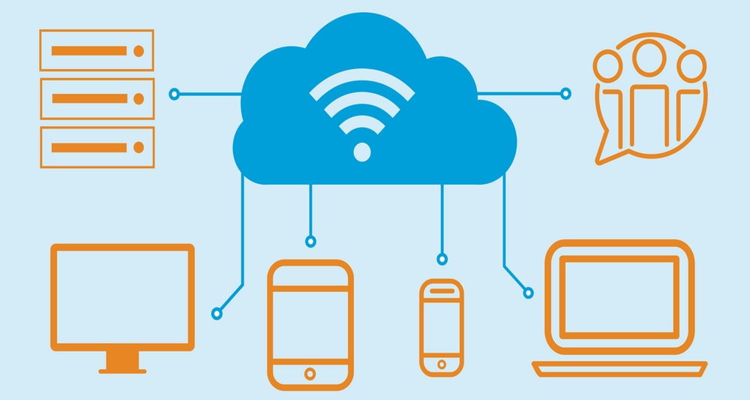
Benefits of cloud computing -
Zero Capital expense
Massive scaling ability
Auto-scaling
Capability to scale up n down rapidly
99.9 % availability
Available from any corner of the world
Zero downtime
Pay as per use
No headache abt maintenance,networking
Easier Troubleshooting

Slide 31
Cloud Providers -
Amazon Web Service - AWS
Microsoft Azure
Google Cloud Platform - GCP
etc.

Slide 32
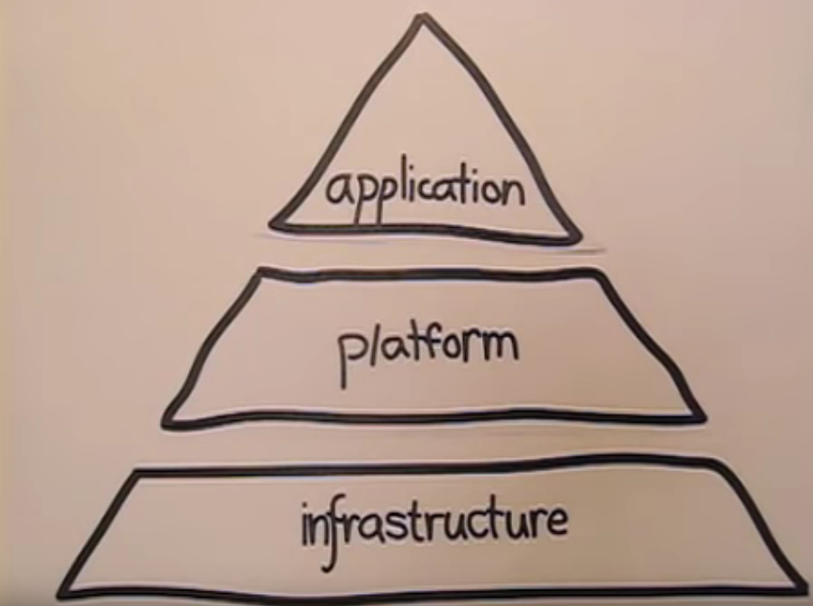
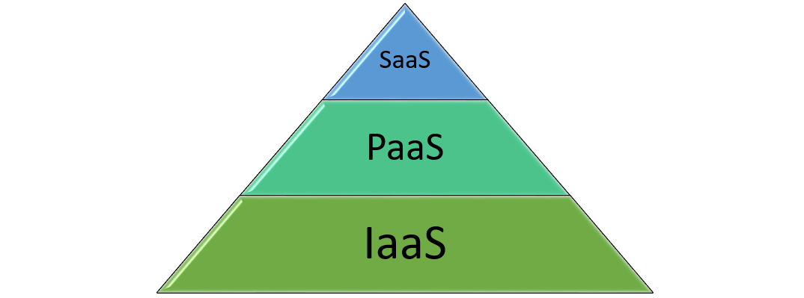
Cloud Service Models -

Slide 33
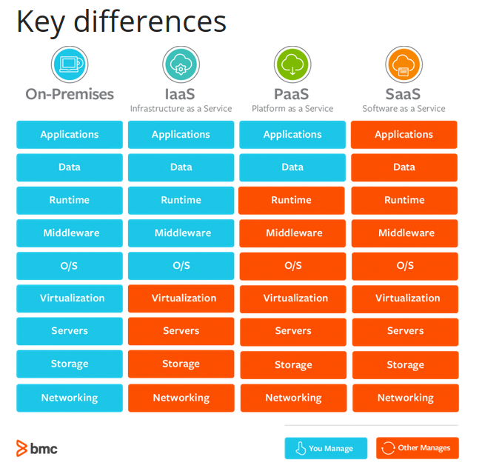

Slide 34
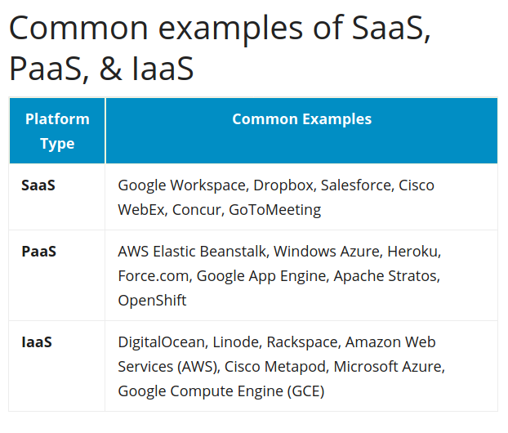

Slide 35
Future of Cloud -
IOT Devices
Artificial Intelligence enabled devices
Heavy computing resources like big data,data analytics

Slide 36
Questions !!
Queries !!
Confusion ??
Feel free & ask

Slide 37
Thanks

